Slide 1
Event Manager Applications
Shahaf Dan
CSCI-19A Java Class

Slide 2
Purpose of Project
to learn about the many applications of Java
To help with the management of the many events many of us have to deal with on the daily basis.

Slide 3
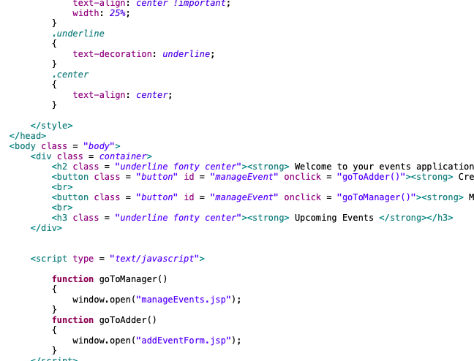
How it Works - Front End
HTML CSS JavaScript Bootstrap API

Slide 4
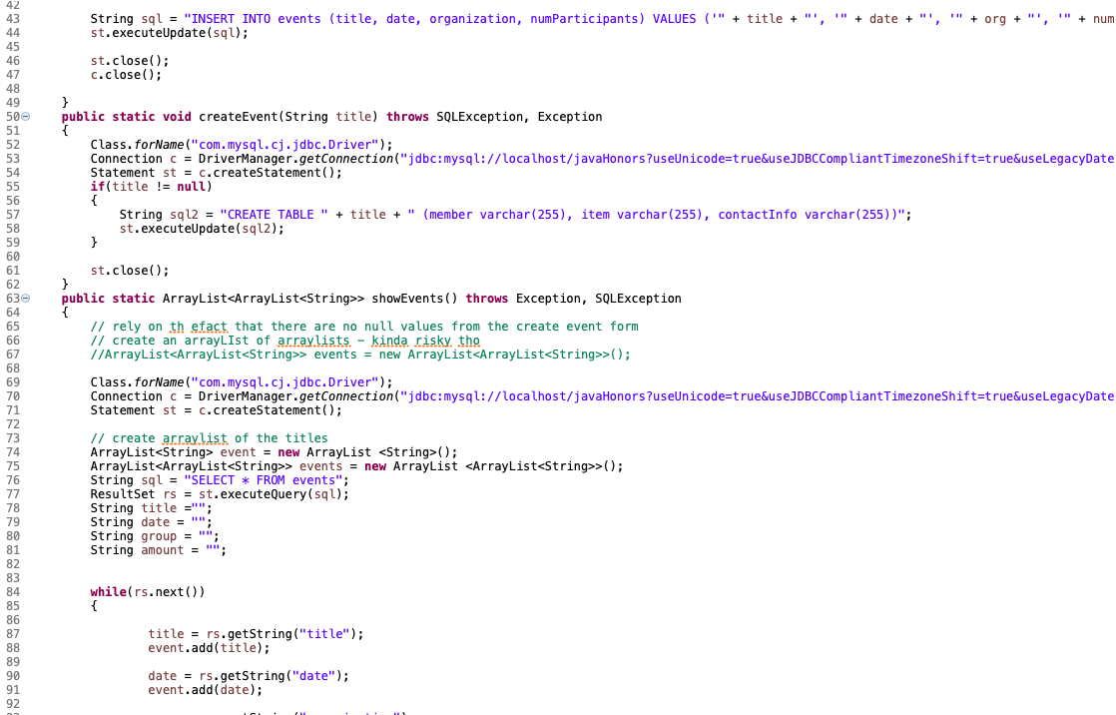
How it Works - Back End
Java EE
Eclipse for Web Developers

Slide 5
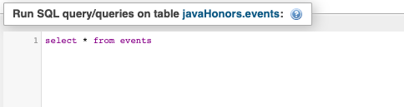

How it Works - Database
MySQL
jdbc
phpMyAdmin

Slide 6
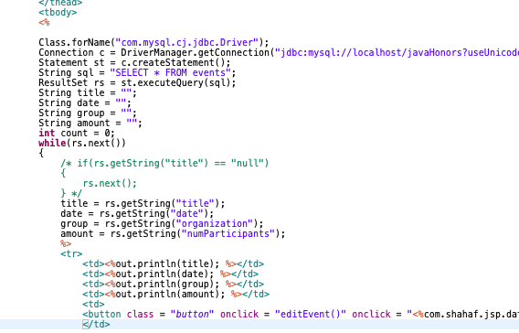
How it Works - Connectors

Slide 7

How it Works - Server
Local Host
Tomcat Server

Slide 8
The Project
Event Manager
Multi User
Cookies
API’s
Future Plans

Slide 9
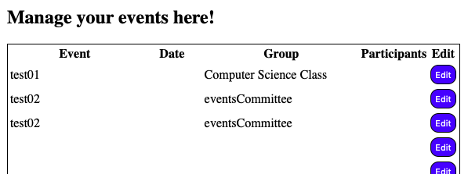
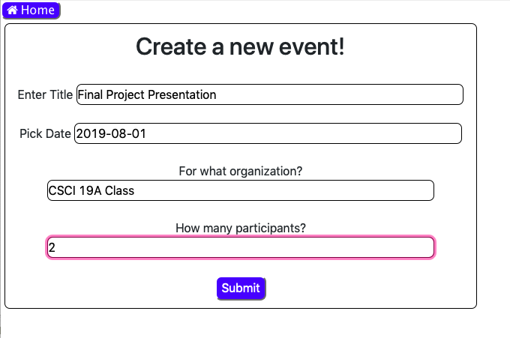

Slide 10
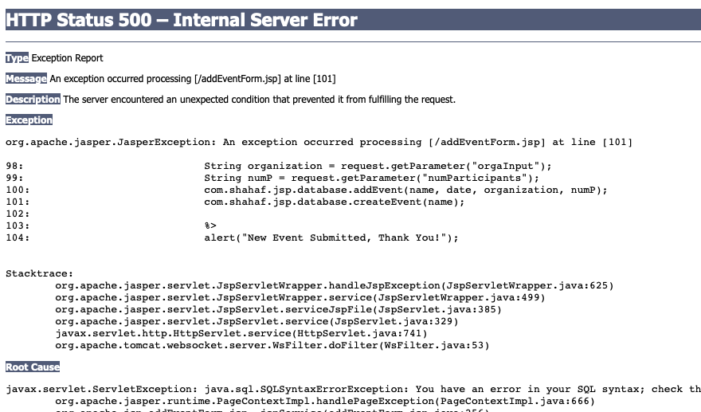
Problems I had to deal with
So So Many Exceptions
Server Connections
Miscommunications between back and front end
Jsp - javascript collisions

Slide 11
Thank you!

